Slide 1
Data Warehouse ——Review the Basic Concepts of Database——
徐华
清华大学 计算机系 智能技术与系统国家重点实验室
xuhua@tsinghua.edu.cn

Slide 2
Data Warehouse
Review the basic concepts of database
What is a data warehouse?
A multi-dimensional data model
Data warehouse architecture
Data warehouse implementation
From data warehousing to data mining

Slide 3
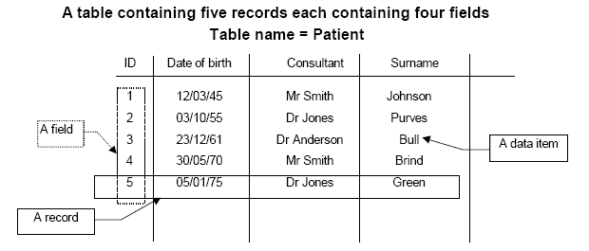
Database (1)
Database is a collection of information in a structured way or a collection of facts.
A shared collection of logically related (and a description of this data), designed to meet the information needs of an organization.
Tables, records and fields:
A database consists of Tables, which consist of records which consist of fields.

Slide 4
Database (2)
Database Management System (DBMS)
A software system that enables users to define, create, and maintain the database and provides controlled access to this database.
Typical DBMS: DB2, Oracle, MS SQL Server, MySQL, MS Access
Dead DBMS: Sybase, Informix
Important functions of DBMS:
Data storage, retrieval (SQL), and update (Create/Insert, Read, Update, Delete)
Transaction support
Ensure that either all the updates corresponding to a given transaction are made or that none of them are made.
Concurrency control services
Ensure that the database is updated correctly when multiple users are updating the database concurrently.
Other functions (Refer to Database Textbook)

Slide 5
Thanks！
Notes:
工作新意图发现

